Slide 1
Vasavi College of Engineering
Department of Information Technology
Abstract Presentation-1
Title:Price Recommendation website
Team Members:
Hall Ticket No. Name
1602-21-737-027 Laxman Sai Prakash
1602-21-737-030 Lokesh Munagapati
1602-21-737-059 Surya Teja
Date:14-11-2022

Slide 2
CONTENTS:
Abstract
Introduction
Hardware and Software Requirements
Design
Implementation
Conclusion
References

Slide 3
ABSTRACT:
Price comparison websites are becoming more popular since Ecommerce revolution. The data and values provide by the price comparison sites helps consumers to save money while shopping online. The ability to check the price of products brings convenience and saves a lot of time. Price comparison is done when the price of the same product is compared in different outlets. There are many online shopping sites which are being used to shop various products online. A particular product has different prices on every different shopping site. We need to check manually the price of the product on every site, which causes inconvenience and consumes a lot of time. There are many price comparison sites which provides products comparison, but there is no site which compares the price of wish list products. Hence, we have proposed a project named Wish list Products Price comparison website which compares the prices of only interested products which user intents to buy. This price comparison website for wish list products will help to compare the price from various e-commerce websites. This system has an advance feature of sending notification when the price changes of a particular product which has been added in the wish list.

Slide 4
This Price comparison site is extremely helpful for frequent online shoppers to check prices on different online stores in one place. This system will show you the product prices from different retailers to show you where to buy the product at affordable price. Whenever the price of the product changes it sends notification to the user.
Python libraries for web scraping:
Beautiful Soup: Extracting data, Filtering data, Navigating data
Can extract all of text from HTML tags
Selenium: used to automate web browser interaction from Python

Slide 5
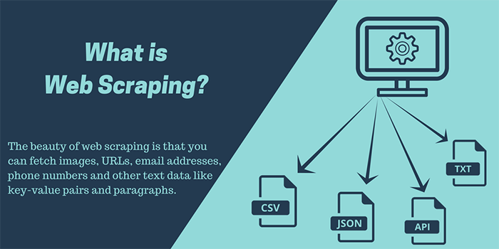
INTRODUCTION:
As you can see we are building this application using python language. which is now a trending language among the tech world. python can also be used to build web development and for this project we are making web scraping from different ecommerce websites.
Web scraping is an automatic method to obtain large amounts of data from websites. Most of this data is unstructured data in an HTML format which is then converted into structured data in a spreadsheet or a database so that it can be used in various applications.

Slide 6
Web scraping requires two parts, namely the crawler and the scraper. The crawler is an artificial intelligence algorithm that browses the web to search for the particular data required by following the links across the internet. The scraper, on the other hand, is a specific tool created to extract data from the website.
A CSV file is a simple text file that you can open in a wide variety of programs, including any program that works with plain text like the Notepad app.

Slide 7
Hardware and Software Requirements:
Framework:
-Flask
-Jinjo
FrontEnd:
-HTML
BackEnd:
-Python
Hardware Requirements :
These requirements include the minimum processor speed, memory, and disk space required to install Windows. In almost all cases, you will want to make sure that your hardware exceeds these requirements to provide adequate performance for the services and applications running on the server.

Slide 8
DESIGN:
Actors wise Use Cases(Features of your project):
User Web Scrapping • Search a item • Collects data from different E-commerce
websites.
• Puts the data into datasets. • Using python
Datasets • The data which is
collected from different
websites will be loaded into
a new datasets everytime. • Show books status

Slide 9
DESIGN:
Use-Case Diagram
Framework
Searches for item
Web Scraping
Redirecting to the selected item website through url
Showcasing the csv table

Slide 10
Use-Case Descriptions
Use Case ID: UC01
Name: Search
Actors: User
Description: Allows user to search for product
Pre-conditions: None
Post-conditions: None
Main Flow:
User | System
Search | Search for the item that user as entered in a shopping website, then extracts the data related to that item and puts into a csv file.Now it displays the csv table in the frontend.

Slide 11
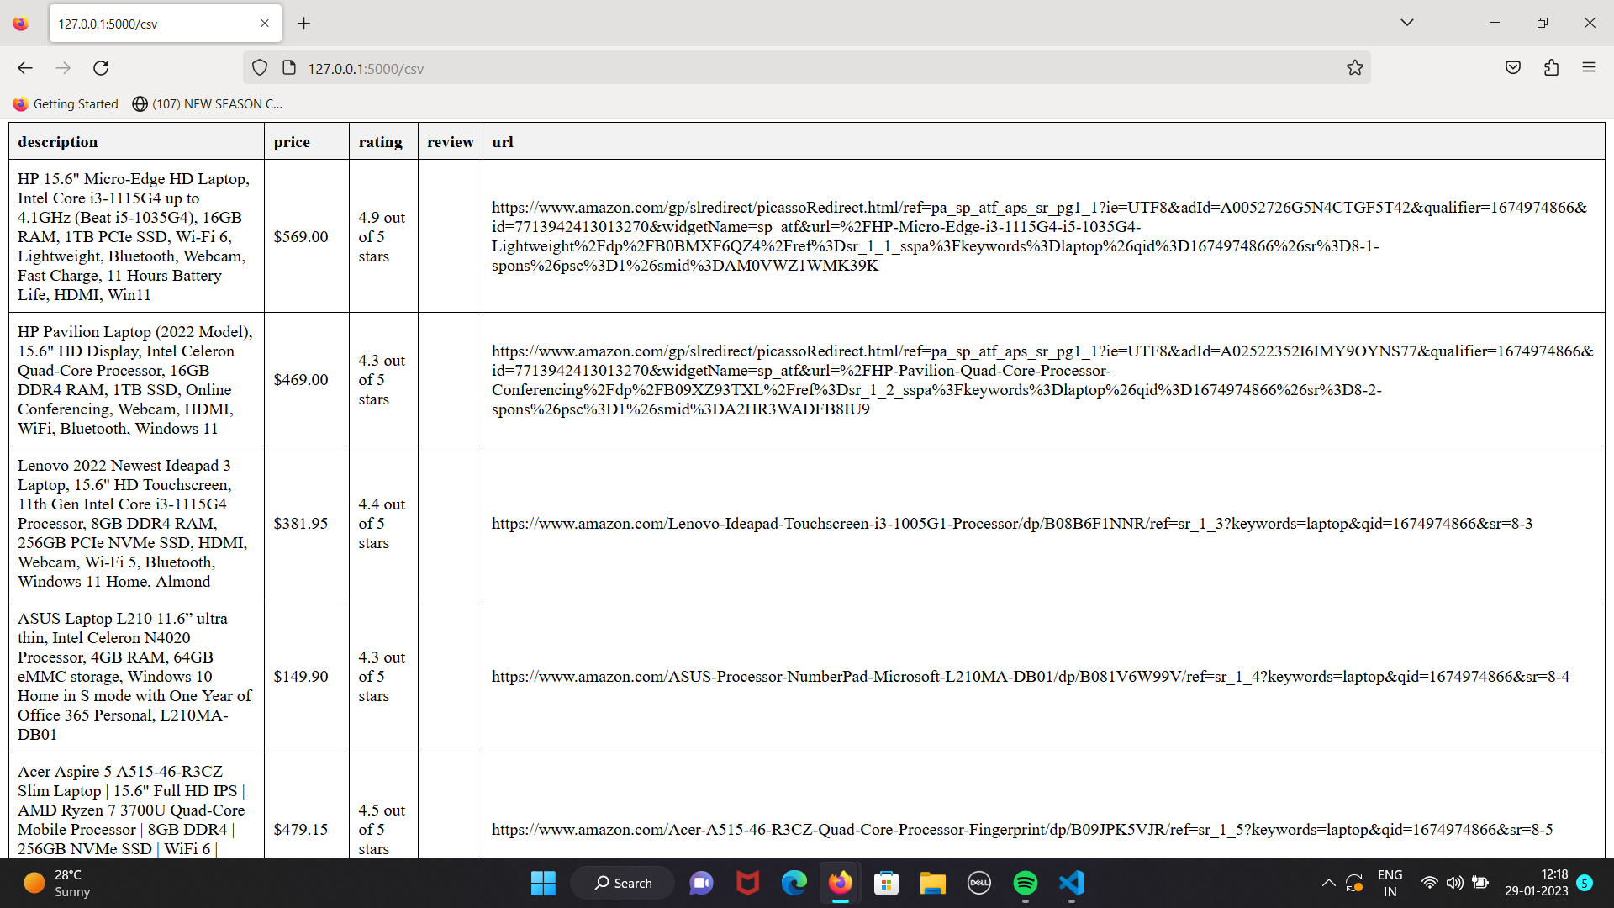
SCREENSHOTS OF EXECUTION

Slide 12
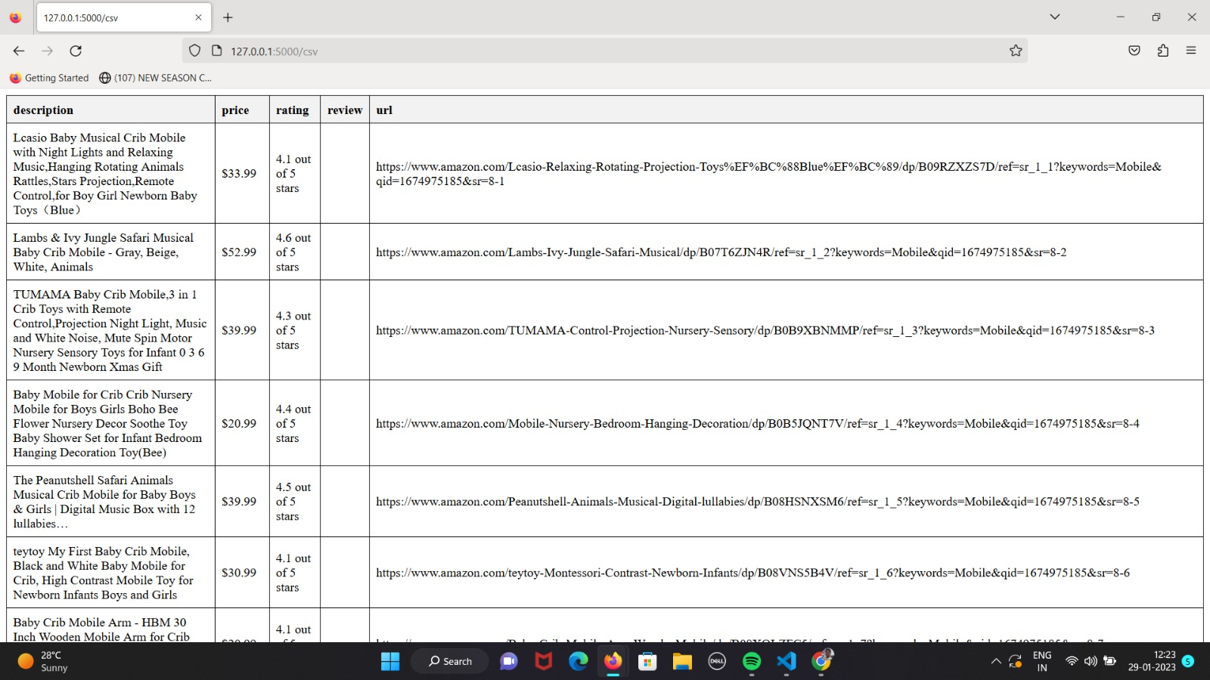
SCREENSHOTS OF EXECUTION

Slide 13
CONCLUSION AND FUTURE PLAN :
This project gives you a precised information in a simpler tabular manner in a csv file about product
It has a scope of improving its features like adding a URL text to hyperlink , including other online websites and comparing their prices

Slide 14
REFERENCES:
Internet.

Slide 15
THANK YOU

